Slide 1
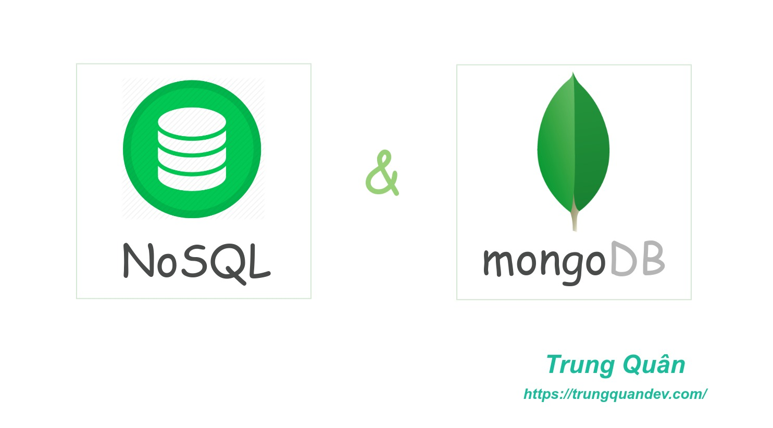
MongoDB vs. SQL: A Comparative Analysis
Understanding the Differences Between NoSQL and Relational Databases

Slide 2
What Are SQL Databases?
Definition: SQL (Structured Query Language) databases are relational databases that use structured schemas to define how data is stored.
Key Features:
Data is stored in tables (rows and columns).
Schema-based (strictly defined structure).
Uses SQL for querying data.
Well-suited for ACID compliance (Atomicity, Consistency, Isolation, Durability).
Examples: MySQL, PostgreSQL, Microsoft SQL Server.

Slide 3

What Is MongoDB?
Definition: MongoDB is a NoSQL database that stores data in a flexible, schema-less format using JSON-like documents (BSON).
Key Features:
Data is stored as documents in collections.
Schema-less, allowing dynamic structure.
Suited for hierarchical or complex data.
Scales horizontally (distributed across multiple servers).
Use Cases: IoT, real-time data, flexible data structures.
Visuals: Diagram of a JSON document and a collection.

Slide 4
Comparison: SQL vs. MongoDB
SQL | NoSQL
Relational | Non-Relational
Structured query language | Dynamic and unstructured
Table-based | Document/ key-value pairs/ graph/ wide-column stores
Vertically scalable | Horizontally scalable

Slide 5

Conclusion and Use Cases
When to Choose?
SQL Databases:
Best for applications needing structured data, consistency, and multi-row transactions.
Examples: Banking systems, CRM, ERP.
MongoDB:
Ideal for applications requiring flexible schemas, fast prototyping, and scalability.
Examples: Real-time analytics, IoT, social networks.

